Slide 1
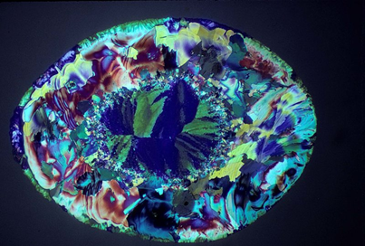
Reinforcement Learning for Batch Crystallization
Jonathan Pershing
Aaron Bigelow
April 23, 2025
https://www.youtube.com/shorts/kbLcqvAOSTA

Slide 2
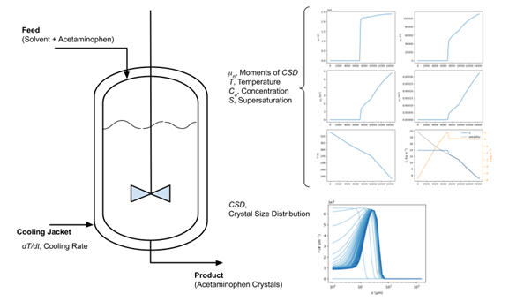
Introduction
Batch crystallization involved cooling down a solution and precipitating crystals from that solution
Uses: pharmaceuticals, fertilizers, crystalline chemicals
We implemented an RL controller to adjust the temperature, leading to bigger crystals with smaller variations

Slide 3
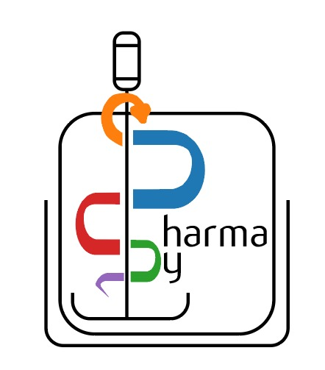
Theory/Methods
Pharmapy: Crystallization simulations
Gymnasium: Environment for RL
Pytorch: Actor and critic for RL
Actor limited to -0.5 – 0.5 temperature change
Reward based on D50 and span
https://pharmapy.readthedocs.io/en/latest/?utm_source=chatgpt.com#

Slide 4
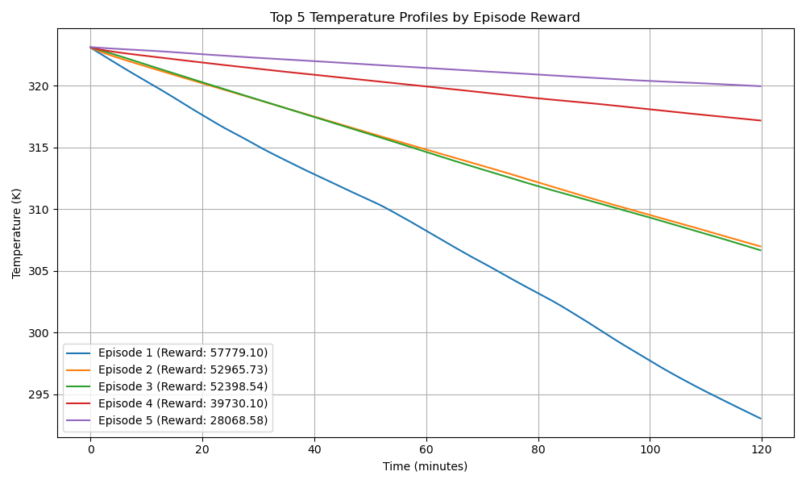
Results
episode | total_reward | D50 | span
1 | 57779.1 | 80.24743 | 0.906007
2 | 52965.73 | 81.81283 | 1.001634
3 | 52398.54 | 81.50371 | 1.000941
4 | 39730.1 | 70.10709 | 1.191153
5 | 28068.58 | 60.10429 | 1.435064

Slide 7
Discussion
Model Limitations
Pharmapy may not have perfect simulation. We suspect this may be the case since the linear model performed the best
Model Issues
The actor and critic loss functions stabilize around 50 episodes even though the reward doesn’t increase
The RL controller doesn’t seem to ‘learn’ as well as we wanted

Slide 8
Conclusion
We were able to get the RL controller to work, but not perfectly
The RL controller can adjust the temperature profile, but it does not learn as well as we hoped
We can still update our RL controller for better optimization
We learned developing and RL controller is difficult because small adjustments can make a large difference

Slide 9
References
[1] B. Benyahia, P. D. Anandan, and C. Rielly, “Robust Model-Based Reinforcement Learning Control of a Batch Crystallization Process,” in 2021 9th International Conference on Systems and Control (ICSC), 2021, pp. 89–94, doi: 10.1109/ICSC50472.2021.9666494.
[2] B. Benyahia, P. D. Anandan, and C. Rielly, “Control of Batch and Continuous Crystallization Processes using Reinforcement Learning,” in 31st European Symposium on Computer Aided Process Engineering, vol. 50, M. Türkay and R. Gani, Eds. Elsevier, 2021, pp. 1371–1376.
[3] V. Manee, R. Baratti, and J. A. Romagnoli, “Learning to navigate a crystallization model with Deep Reinforcement Learning,” Chem. Eng. Res. Des., vol. 178, pp. 111– 123, 2022, doi: https://doi.org/10.1016/j.cherd.2021.12.005.
[4] D. Casas-Orozco, D. Laky, V. Wang, M. Abdi, X. Feng, E. Wood, C. Laird, G. V.Reklaitis, and Z. K. Nagy, “PharmaPy: An object-oriented tool for the developmentof hybrid pharmaceutical flowsheets,” Computers & Chemical Engineering, vol. 153, p.107408, Oct. 2021, doi: 10.1016/j.compchemeng.2021.107408, link.

